Slide 1
YourSafety
Safety installations ltd.

Slide 2
Information
Where:
in show-rooms
on site
When:
also at night
also at weekends
How:
By top technicians

Slide 3

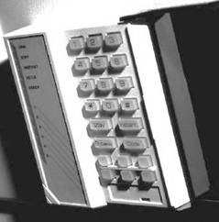
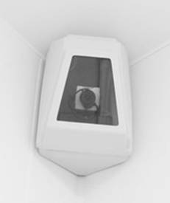

Products
Safety doors
Alarm systems
Video surveillance
Intercoms
Cameras
Vaults

Slide 4
Customer service
In-house service
5-year warranty
competent
fast
safe
inexpensive

Slide 5
Offices
Contact data
Headquarters in Zurich
Offices in:
Vienna
Berlin
Bern
Planned in:
Salzburg
Mailand

Slide 6
Management
Petra Schuster
Manager
Manuel Gruber
Sales
Tanja Eder
Accounting
Klaus Kerner
Marketing

Slide 7
Turnover

Slide 8
Customers

Slide 9
Employees
Office | Assembly
Zurich | 21
Vienna | 15
Berlin | 12
Bern | 9

Slide 10
Contact
YourSafety Safety installations Ltd. 8001 Zurich, Mainstreet 65 phone: +41 44 960 11 22 fax: +41 44 960 11 23 e-mail: office@yoursafety.com web: www.yoursafety.com

